Slide 1
110th US Senate
Tony Hung
Notes:
Please note, nothing should be derived from these slides.

Slide 2
US Senate
The US Congress is divided into two houses: Senate and the House of Representatives.
Each state sends two senators to congress
110th Congress: January 2007 – January 2009
George W. Bush was the president at that time (2nd term)
Democrats have the majority in both chambers of the congress
For this project, we are using each senators as the nodes/vertices and the bills they have co-sponsored as the edges
Co-sponsorship is important. It shows that the senator is in support of such bill presented to the Senate. It also reveals what issues that senator supports, what their political stance is…

Slide 3

Goal
For this analysis we are trying to answer the following questions:
Who was the most influential senator?
Centrality measures
Does party membership influence bill co-sponsorship?
Blockmodelling and Louvain community detection algorithm
What are the social structures of the senate?
Dendrogram and structural equivalence
Which attributes predict bill co-sponsorship?
Exponential Random Graph Model (ERGM)
But first, we would have to split the graph…

Slide 4
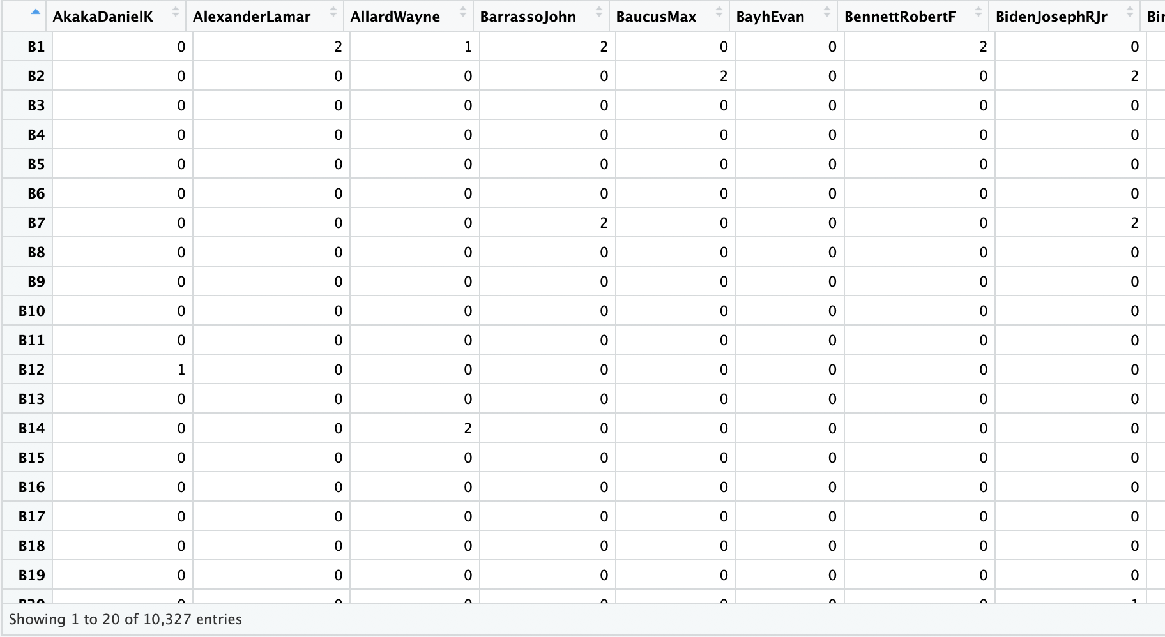
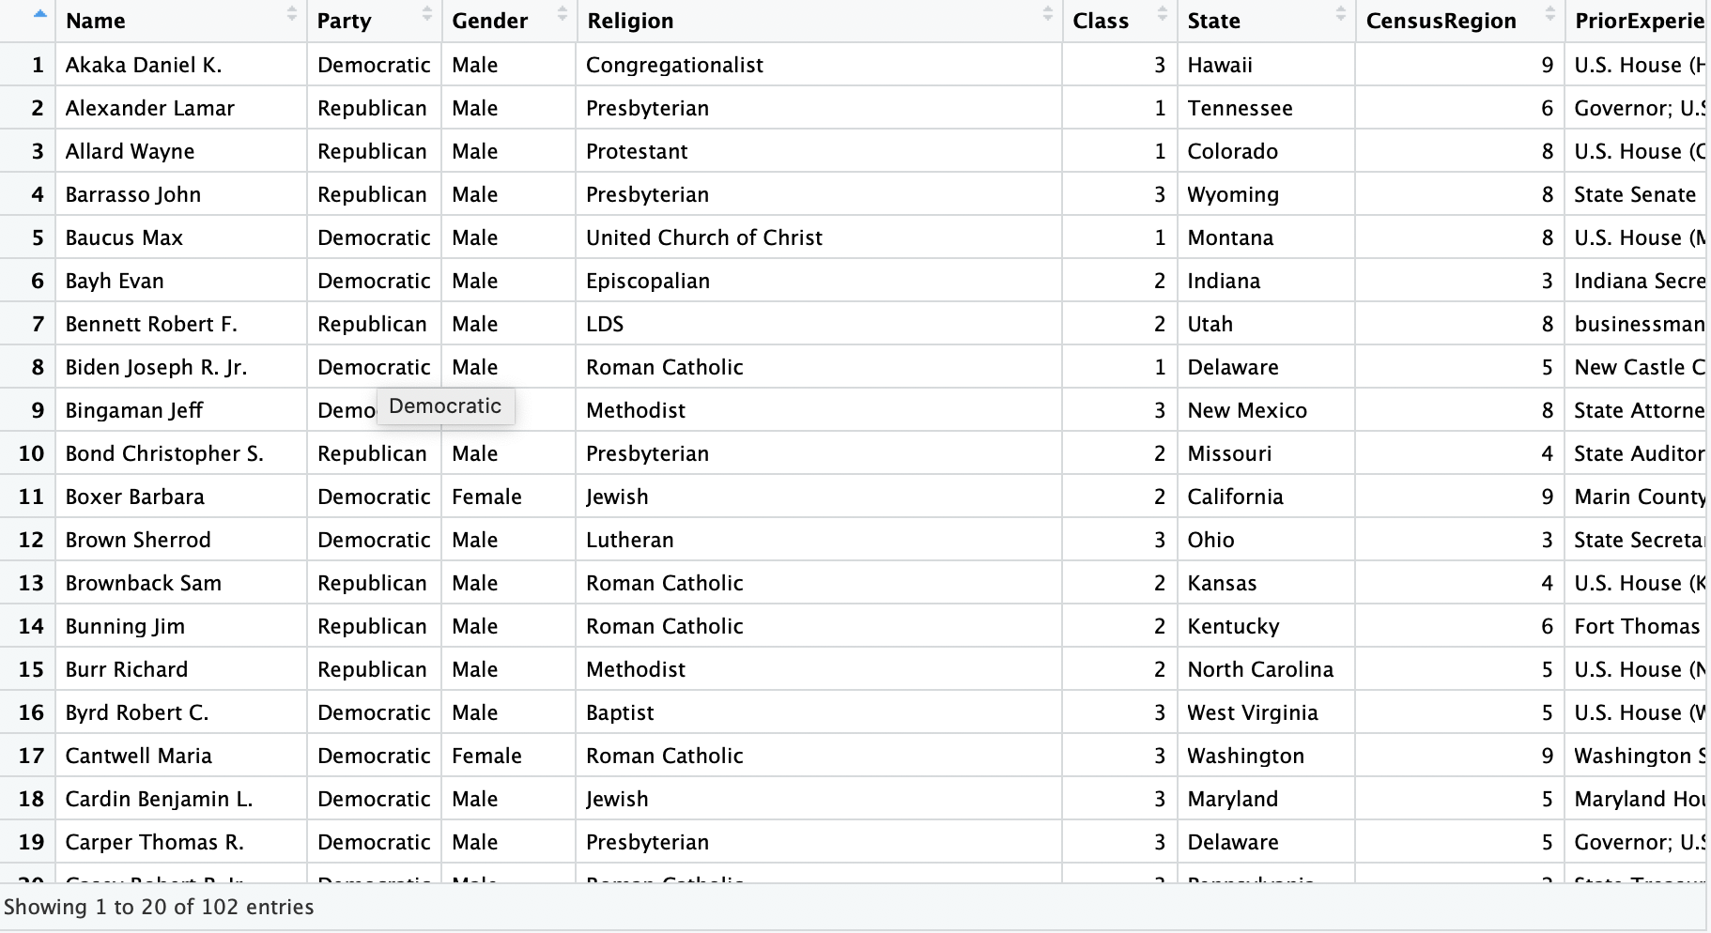
Data
Notes:
The top right matrix is the dataset where it contains all the senators and the bills. If there is a non-zero number in the cell, it means that the senator has sponsored such bill. The different numbers represent weights. The weights could signify if a senator was the main sponsor (the original proposer of the bill) or part of a group of sponsors.
The bottom left matrix contains all the characteristics of the senators. To make networks/graphs, we would somehow need to add the the characteristics into the first matrix and then graph it!
Original data source: http://jhfowler.ucsd.edu/cosponsorship.htm

Slide 5
Attributes
Name: the official name of each senator
Party: which political party the senator belongs to
Gender: male or female
Religion: which religion the senator identifies with
Class: when their seat in the senate will be free for election again
State: which state the senator represents in the senate
Census Region: shows which census region the senator represents according to the United States Census Bureau
Prior Experience: what jobs the senator held before entering the US Congress
Education: the highest level of education
First Took Office: the year senator first took office
Born: shows the year when the senator was born
Notes:
In this meeting of the senate, there are three classes. The first class is 2009. The second class is 2011. The third class is 2013. These classes do not represent any hierarchy or social standing. It merely represents when the seat will be free for election again. For example, John McCain (R) was a class 2 senator and this means that his seat in the senate will be free in 2011.
In the 110th US Senate, there are two senators who were replaced. Craig Thomas (R) passed away in April 2007 and was replaced by John Barrasso (R). Trent Lott (R) resigned in December 2007 and was replaced by Roger Wicker (R). For our analysis, all four senators will be included.
There are currently 9 division of census regions in the United States. More information here.

Slide 6
US Census Regions
Notes:
Source: https://www2.census.gov/geo/pdfs/maps-data/maps/reference/us_regdiv.pdf

Slide 7
Descriptive Statistics
51 Democratic senators and 51 Republican senators
16 Females and 86 Males
Biggest groups of religion:
Roman Catholic: 25
Jewish: 13
Methodist : 13
The longest serving senator: Robert Byrd (D), started in 1959
Oldest senator: Robert Byrd (D), born in 1917
Youngest senator: John Sununu (R), born in 1964
Average age of senators in 2007: 63 years

Slide 8
Full Network
Notes:
This is the plot of the full network. We see that everyone is connected to everyone. In fact the degree centrality (the total number of edges) for each senator is 101! This means that everyone is connected to everyone in the senate and everyone has co-sponsored with everyone during the two year period. This is quite amazing, but the completeness of the graph would not allow us for a more thorough investigation, and that is why we would need to extract a part of the full network and closely examine it.
We will extract the graph based on the weights of the edges and all of our analysis will be on either or both networks.

Slide 9
Simplified Network
Notes:
Which part of the network should we extract? After playing around for a bit on R, I think the top 25% (75th quartile) shouild be extracted. This is because the top quartile is distinct enough in comparison to to the other divisions (e.g. 50% or 25%). When you want to analyze a group of elites, you would want to analyze the elites of the elites, thus I think the 75th quartile is a great extraction.
From this graph, we see that there are a few isolated senators, because they did not meet the cut. These are: Richard Shelby, Roger Wicker, Craig Thomas, John McCain, Trent Lott, Mitch McConell, Jon Kyl, John Ensign, John Barrasso, Robert Bennett, Chris Bond, and Robert Byrd. All these islotates besides Byrd are Republican senators.
The interesting thing about these isolates is that some of them were in high positions. Robert Byrd was the president pro tempore. Jon Kyl was the Republican conference chairman. John Ensign was the national Republican senatorial committee chair. John McCain was the Republican nominee for US President. Mitch McConnell was the minority leader.

Slide 10
Network Statistics
 | Number of Edges | Number of Nodes | Density | Average Path Length | Transitivity | Diameter
Full | 5151 | 102 | 1.0000000 | 1.000000 | 1.0000000 | 74
Simplified | 1305 | 102 | 0.2533489 | 1.859675 | 0.7622924 | 507
Notes:
Density is the percentage between number of edges in the network and the total possible number of the network. The density for the full network is 100%, meaning that it is fully connected. The density for the simplified network is 0.253, which means that only 25.3% of the network is connected.
Average path length is the average number of steps from one node to another node. In the simplified network, it takes 1.9 steps on average from one senator to another.
Transitivity measures how likely a triad a form. In the simplified network, there is a 76.2% chance that two senators of a vertex are themselves connected.
Diameter measures the longest path in the network. In the full network, the maximum number of steps from one senator to another is 74. In the simplified network ,the maximum number of steps from on esenator to another is 507 steps!!!!!
The simplified network is an example of the small-world phenomenon with low density and high transitivity.

Slide 11
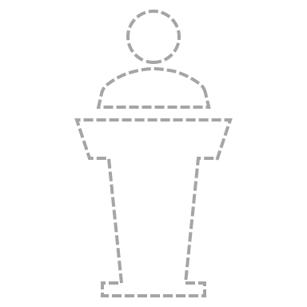
Who was the most influential senator?
Centrality Measures

Slide 12
Centrality Measures
 | Degree Centrality | Eigenvector Centrality | Closeness Centrality | Betweenness Centrality
Simplified Network | 69 Norm Coleman (R) | 1 Hillary Clinton (D) | 7.502e-04 Norm Coleman (R) | 771.229 Norm Coleman (R)
Notes:
This section is based on the simplified network, because in the full network every senator would have the same centrality measures…
We know that degree centrality measures the total number of edges. Eigenvector centrality measures influence based on the connections each node has. It is a relative measure. So if you are a person who has connections to a lot of powerful people, then you will have high eigenvector centrality. I think Regina George (pre-Cady era) from Mean Girls would be a good example, as she is the most popular girl in the group of popular girls.
Closeness centrality measures the average of the shortest path lengths for each node. Thus, the higher the value, the closer you are to everyone else in the network. Betweenness centrality measures the number of unique edges each node has. It also means that how the node can serve as a broker between other nodes (the strength of weak ties).
Coleman has 69 edges, the highest closeness, and the highest betweenness. This means Norm Coleman is a broker between senators. He patches over holes in the senate. Norm Coleman is the guy you want to call when you need some introduction. Clinton on the other hand is influential in the sense that she is the crème de la crème. The most popular girl, but does this mean she has more advantage than other senators?

Slide 13

Does party membership influence bill co-sponsorship?
Stochastic Blockmodeling
&
Louvain Community Detection Algorithm

Slide 14
Stochastic Blockmodelling
Notes:
Here we see a comparison between the block model and the simplified network. The block model is based on the simplified network. In the block model, we can see that there is a group of Democrats in a cloud of Republicans. Block modelling is an algorithm that will try to detect groups based on a given network data.

Slide 15
Probability
 | Democratic | Republican
Democratic | 0.6533333 | 0.1218762
Republican | 0.1218762 | 0.1215686
Notes:
From the block model, we can calculate the probability of a tie. There is a 65.3% chance that two Democrats will form a tie. There is a 12.2% chance that a Republican and a Democrat will form a tie. There is 12.2% chance that two Republicans will form a tie. This means that the Democrats are tightly knitted and the Republicans are more loose.

Slide 16
Louvain Community Detection
Notes:
The Louvain is based on the full network. The algorithm identifies two main groups in the full network. The red group mainly consists of Republicans and the blue group mainly consists of Democrats.

Slide 17
Comparing results of the Louvain algorithm
 | Community 1 | Community 2
Democratic | 1 | 50
Republican | 47 | 4
Notes:
Here we can compare the results of the algorithm to our actual network. We can see that the there is 1 Democrat and 4 Republicans mismatched by the algorithm.

Slide 18
Comparing Louvain with other attributes
Attributes | Comparison Scores against Louvain Algorithm
Party | 0.73048434
Class | 0.02997089
Census Region | 0.13010106
Gender | 0.05722225
Religion | 0.14404113
First Took Office | 0.07656904
Born | 0.10265503
Notes:
Now, let’s compare the Louvain model with the other attributes. Party is the most similar then comes religion, census region, and then born. The party attribute is 73.04% similar to the Louvain model. It has been argued that religion influences politics with many researchers agreeing on this. Geography could potentially influence politics, but it is unclear. I personally believe with geography, it’s more about trying to represent the people who voted you in. In the US there are red states and blue states, as well as swing states. The red states tend to be the south or the less populated states e.g. Utah.

Slide 19

What are the social structures of the senate?
Dendrogram
Structural Equivalence

Slide 20
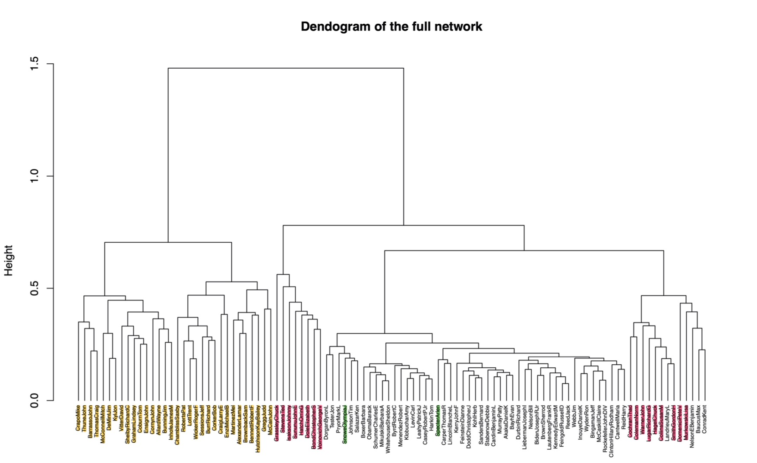
Dendrogram
Notes:
This dendrogram is computed using hierarchical clustering, ‘complete’ method, and it is based on the full network. It’s an agglomerative method (bottom-up). The lower the height, the more similar they are. The highlighted names are the Republican senators. At around height 0.75, we see that there are four distinct clusters. The first three clusters (highlighted yellow and the first group of pink from the left), are all Republican senators. This dendrogram is very interesting in the sense that there are two Republican senators within the big group of Democrats. These two are Olympia Snowe and Arlen Specter. Specter was a Democrat then turned Republican then in 2009 switched back to Democrat again. Snowe was often voting in line with the Democrats.
What about that little group on the right with a mix bag of Republicans and Democrats (occurred at around height = 0.5)? The four Democrats in that group are often considered as the conservatives in the Democratic Party.
What does this mean in general? It means that the co-sponsorship network reveals some truths about the senate. First, not every party member votes in line with their own party. Second, the Democrats are a tightly knitted group.

Slide 21
Structural Equivalence
Notes:
From the results of the dendrogram, we can now place the senators into four groups.

Slide 22
Equivalency classes and party membership
 | Democratic Party | Republican Party
Class 1 | 51 | 11
Class 2 | 0 | 16
Class 3 | 0 | 16
Class 4 | 0 | 8
Notes:
All 51 Democrats are placed into class 1, but the Republicans are spread over the remaining classes.

Slide 23
Equivalency classes and census regions by party membership
 | Census Region 1 |  | Census Region 2 |  | Census Region 3 |  | Census Region 4 |  | Census Region 5 |  | Census Region 6 |  | Census Region 7 |  | Census Region 8 |  | Census Region 9
Class 1 | 8 | 2 | 5 | 1 | 8 | 1 | 7 | 2 | 8 | 1 |  | 1 | 3 |  | 5 | 1 | 7 | 2
Class 2 |  | 1 |  |  |  |  |  | 2 |  | 3 |  | 5 |  | 1 |  | 4
Class 3 |  |  |  |  |  |  |  | 1 |  | 2 |  | 3 |  | 4 |  | 6
Class 4 |  | 1 |  |  |  | 1 |  | 2 |  | 2 |  |  |  |  |  | 1 |  | 1
Notes:
If we look at the structural classes by the party and region, perhaps we can see more of a differentiation. In region 4 and 5, there are equal representations from both parties.
Some might ask we am I not analyzing religion as a factor. Religion is a sensitive and complex subject. Without the complete knowledge of religious studies, it is rather difficult to analyze the religion attribute of the network. This is mainly due to too many religion categories thus for better efficiency, it is better to group similar faiths together. But without a complete understanding of each of the faith listed in the variable, it is impossible to categorize the faiths. I have thought that since the biggest religions in the senate are Roman Catholics and Jewish, so I thought maybe it could be Catholics=1, Jewish=2, Others=3, but this means that there might be important information lost in the process due to this overgeneralization.

Slide 24

Which attributes predict bill co-sponsorship?
Exponential Random Graph Model

Slide 25
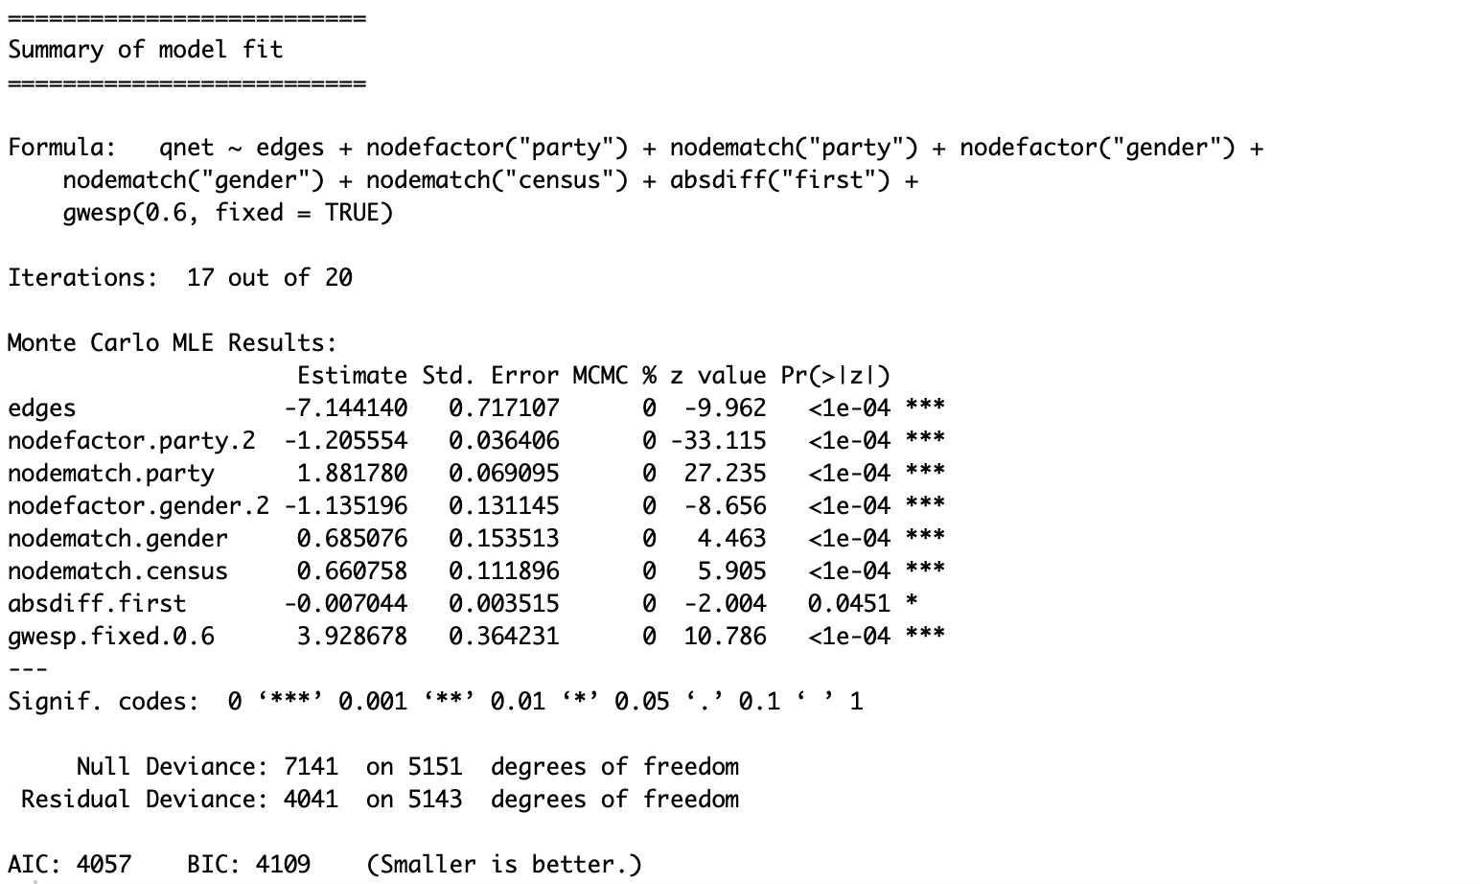
ERGM output
Notes:
Overhere, I have made an ERGM model based on the simplified model. ERGM is very similar to logit/probit, but it is specifically made for networks. Nodes in the networks are not statistically independent, thus it violates one of the assumptions for logistic regression already. Also, logistic regression does not offer the flexibility as much.
In logistic regression, you are estimating the likelihood of something going to happen based on some variables. ERGM is the same. You will have exponentiate the coefficients to understand the meaning by using the formula e^(estimate).
All terms are statistically significant besides absdiff.first, which is a term on the absolute difference when the senators first took office. According to this model, a republican senator is 0.3 times as likely to have ties with other senators (nodefactor.party.2). A male senator is 0.33 times as likely to have ties with other senators (nodefactor.gender.2). This means that a republican senator tends to have 70% less ties with other senators and a male senator tends to have 67% less ties with other senators.
If two senators are in the same party, then they are e^(1.881780) = 6.565 times as likely to have ties than different parties (nodematch.party). If two senators have the same gender, then they are 1.98 times as likely to have ties than different genders (nodematch.gender). If two senators come from the same census region, then they are 1.94 times as likely to have ties (nodematch.census). If two senators took office further apart, then they are 0.993 times as likely to have ties. This means that as the years of two senators took office increases by one, then those two senators are 0.993 times as likely to have ties with every additional year of difference, and so on and so forth…
I do have to say, I am not very good at this part of the analysis. I’m not saying the model I’ve produced over here is the best either, but it is a work in progress.

Slide 26

Conclusion

Slide 27
Conclusion
What have we learned so far?
Norm Coleman is the most influential senator
Party membership could influence bill co-sponsorship
SNA is tedious
Senators don’t always vote in line with their party
Of course, there are still more things to be done…
Is religion an important factor in bill co-sponsorship?
Using other methods of clustering and compare it!
A better ERGM with better attributes?
More analysis on the Republican senators: what makes them all over the place?
Notes:
I seriously hope that some of you have enjoyed this brief analysis on the 110th Senate. If you have any more questions, please don’t hesitate to send me an email!
Thank you again for listening!

Slide 28

Thank you!

